Slide 1

Project Proposal on
TRADING OF LARGE-CAP CRYPTOS BASED ON TRADITIONAL FINANCE AND MACRO INDICATORS
Group: Digital Gold Diggers
Team Members: DAWA LAMA,
LI ZHI,
ESTRELLA MOREIRA,
SALEM ALI
Submitted to Prof. Michael Grossberg
City College of New York
DSE G2200 Machine Learning for Finance and Trading
Spring 2022

Slide 2
Team and Group: Digital Gold Diggers
Fund Name: Digital Gold Hedge Fund
We have assigned our team members in following position of project.
Project-Process Manager: Estrella Moreira
Project-Technology: Li Zhi
Project Coordination Manager: Dawa Lama
4. Project Fund Manager: Salem Ali

Slide 3
Summary
Large-Cap crypto have many different definition, so in our analysis will be included 5 crypto companies which has more than 50-billion-dollar market cap.
We have chosen large-cap crypto for trading analysis which is less risky and highly growing in prices.
We will use the S&P Cryptocurrency Broad Digital Market (BDM) Index to determine the overall crypto market as universe.
We will also examine the effect of traditional finance and macroeconomic indicators on cryptocurrency trading.

Slide 4
Crypto Trading
Why cryptocurrencies for investment?
Why large-cap crypto?
Which variable is most responsible in crypto price movement?
Which factors investors need to consider most in making investment decision?
How to macroeconomic variables plays the role on crypto market development ?
Should the macroeconomic variables & crypto index be interrelated ?
Agenda & Problems

Slide 5

Solution & Strategies(1)
Alpha factor analysis to know the return on investment
Large-Cap cryptocurrencies historical price analysis.
Machine Learning analysis which will focused on following goals
Maximize the profit trading of large-cap cryptocurrencies
We will be focused on find out the best investment analysis.
Our strategy will be focused on high return and low risk portfolio building

Slide 6

Objectives
The following objectives we have set in this project we will try to achieve:
1. To study the historical crypto price movement.
2. To test the relationship with S&P Cryptocurrency Broad Digital Market (BDM) Index and selected macroeconomic factors.
3. To suggest which factor need to be consider before making investment decision on the crypto.

Slide 7
Market Universe and Instruments for project
In our project we will use top 5 large-cap cryptos as market universe which has more
than 50 billion market cap and US Dollar (with Euro Dollar rate) will be use as alternate investment.
S.N. | Symbol (Ticker) | Crypto Name | Current market cap (In billion) | Current market price
1 | BTC | Bitcoin | 873.28 | $45,969
2 | ETH | Ethereum | 415.38 | $3,454.23
3 | USDT | Tether | 82.41 | $1
4 | BNB | Binance Coin | 74.408 | $451.09
5 | USDC | USD Coin | 51.48 | $0.9997
Data reported time : 04/05/2022, 14:20 Data source: https://coinmarketcap.com/

Slide 8
Reference Index
We will use S&P Cryptocurrency Broad Digital Market (BDM) Index as our reference index.
The S&P Cryptocurrency Broad Digital Market (BDM) Index is designed to track the performance of digital assets listed on recognized open digital exchanges that meet minimum liquidity and market capitalization criteria that are covered by our price provider Lukka.

Slide 9
Data Sources
Primary Data source Regarding Crypto: coinmarketcap.com and yahoo finance
Additional Alternative Data: Quandl.com, Kaggle, BLS, BEA, and Fred data will be used in our project.
Additional information :
These all sources provide free data.
For live data we will connect out project to Yahoo Finance.

Slide 10
Machine Learning Strategy
We will use following model for MI strategies and model.
K-Nearest Neighbors (KNN)
Classification and Regression Trees (CART)
Support Vector Machines (SVM)
Random Forest (RF)
Gaussian Naïve Bayes (NB)
Deep Learning
Our MI strategies will be focused on:
1. Maximize the profit trading of large-cap cryptocurrencies
2. We will be strongly focused on find out the best investment analysis.
3. Our strategy will be focused on high return and low risk portfolio building

Slide 11
Development process:
For media: Using Slack, WhatsApp for share thought and idea though chatting and asking question.
Using CUNY SharePoint within group for regularly work on project and writing.
We will use GitHub to build up out code and final project.

Slide 12
Data cleaning and EDA
After collecting data, we will investigate the data and check missing data and ensure the quality of the dataset.
Next, will determine which technology to use. Conduct EDA.
Get statistic characteristics and have the overview of how the dataset looks like

Slide 13
We will normalize our data in the range in the range (0.01, 0.99) before feeding it to the the neural network.
from sklearn.preprocessing import MinMaxScaler
Target_scaler = MinMaxScaler(feature_range=(0.01, 0.99))
Feature_scaler = MinMaxScaler(feature_range=(0.01, 0.99))
X_train_scaled = Feature_scaler.fit_transform(np.array(X_train))
X_valid_scaled = Feature_scaler.fit_transform(np.array(X_valid))
X_test_scaled = Feature_scaler.fit_transform(np.array(X_test))
y_train_scaled = Target_scaler.fit_transform(np.array(y_train).reshape(-1,1))
y_valid_scaled = Target_scaler.fit_transform(np.array(y_valid).reshape(-1,1))
y_test_scaled = Target_scaler.fit_transform(np.array(y_test).reshape(-1,1))
Normalize Data
Notes:
We will separate out 5% of the samples (rows) in a random fashion for later testing purposes.
The remaining 95 % is again split randomly. Some 5% of it is used as validation set and the remaining as training set.
All this splitting happens row wise.
Note that we also need to split it column wise as well. The first column are our actual values (target). These aren't fed to the neural network. The remaining 15 columns (input regressors) are fed to it.
So, the slicing of data happens both row wise and column wise. The sliced dataframes having only the regressor input columns typically have a "X" in the names we assign them, and the sliced dataframes (or series) with only the actual values (also called target values, as in being "targets" for the neural netwroks to accurately predict while training) have a "y" in the names we assign them.
Note that since this is time-series data, splitting the dataset randomly isn't a sensible thought. So, for time-series data, we will simply split in an orderly fashion.
We will normalize our data in the range in the range (0.01, 0.99) before feeding it to the the neural network.

Slide 14
Apply ML
We will stick around following ML techniques to maximize the outcome of project.
K-Nearest Neighbors (KNN)
Classification and Regression Trees (CART)
Support Vector Machines (SVM)
Random Forest (RF)
Gaussian Naïve Bayes (NB)
Deep Learning

Slide 15
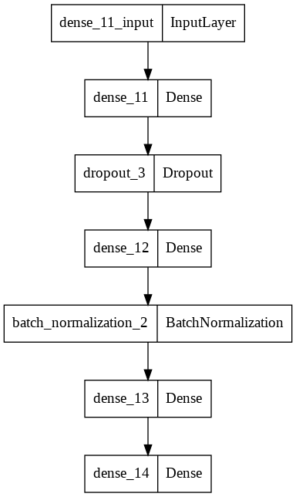
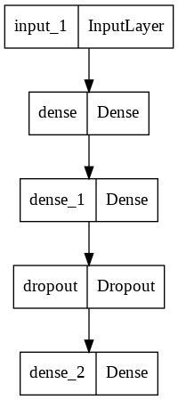
Apply ANN
Notes:
We used two ANN model as shown.

Slide 16
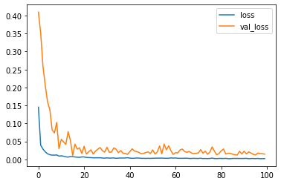
bias-variance tradeoff
Notes:
We can see, at the end, the training loss is very close to the validation-loss, so we can consider it is reliable, no significant overfitting.

Slide 17
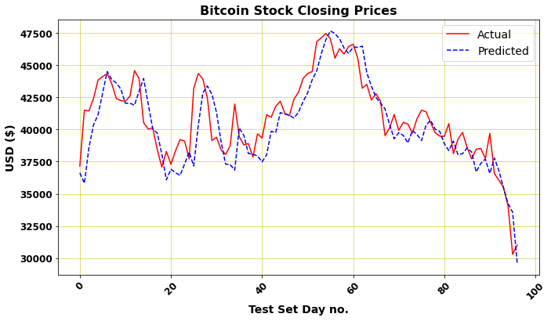
100 days prediction
R-squared score for the test set: 0.6774
Notes:
the predictions are pretty reliable, at least for a forecasting horizon of one day.

Slide 18
Conclusion
Our team will use large-cap top five crypto in trading with best machine learning technique and different strong strategies to maximize the profit.
Our goal is maximizing the profit though finding out best alternative of investment.
Our goal is proper analysis of historical data to find and predict the future income of investment instruments we will use in our project
Thank you
Team-Digital Gold Diggers.

